Slide 1
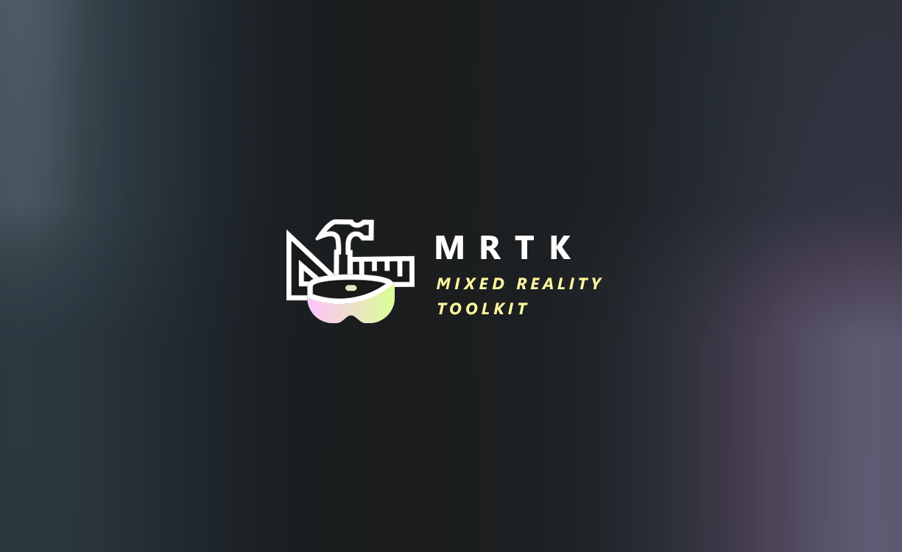

Slide 2
Mixed Reality Toolkit Replacing Controller Models
Quick overview of the MRTK controller configuration
MRTK default controllers
Creating your own models
Replacing the defaults
Tips n Tricks

Slide 3
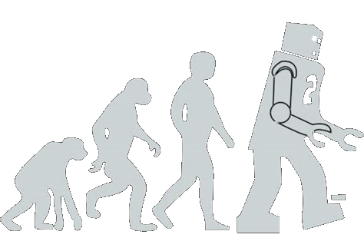
Mixed Reality Toolkit
Multi-Platform
Performance by Default
Individual Components
New Architecture
Centralised Configuration
Mixed Reality Toolkit V2
Centralised Configuration

Slide 4
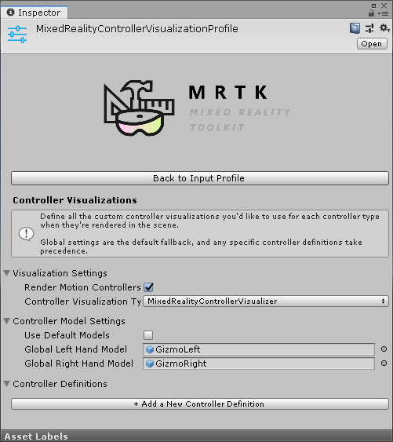
MRTK v2 Controller Visualization MRTK -> Input Settings -> Controller Visualization Profile

Slide 5
Defaults to MRTK Gizmos
Can replace with your own models, even per platform
Platform models coming soon
Rendered model
Platform Default (coming soon)
Global model
Platform specific override

Slide 6
Prefabs need a specific hierarchy
Enables models to be altered without affecting connection to the controller
Watch for Scale!
Attachment Point
Model
Animations
Requires “Mixed Reality Controller Visualizer” script

Slide 7

Demo
Walking through the configuration wilderness

